Slide 1
Sub-Query

Slide 2
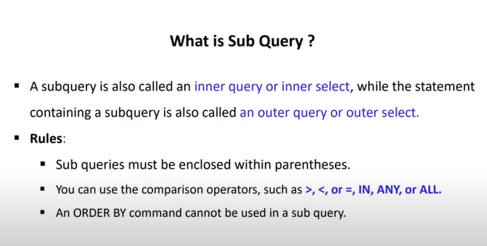

Slide 3
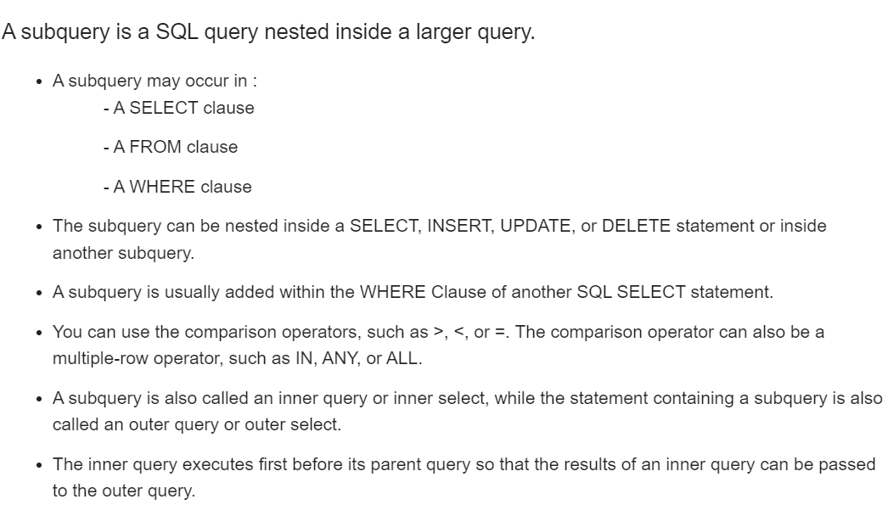

Slide 4


Slide 5
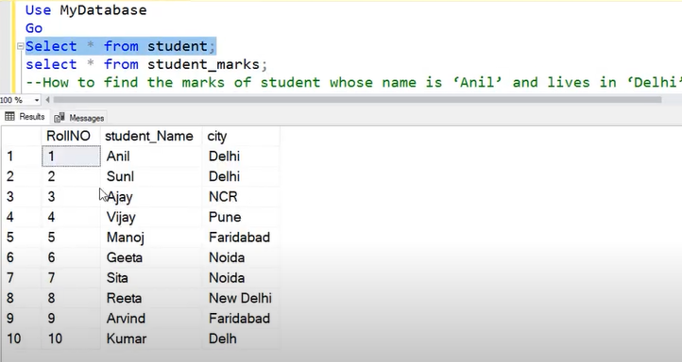

Slide 6
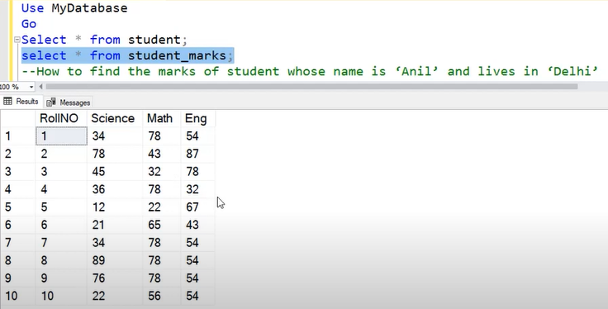

Slide 7
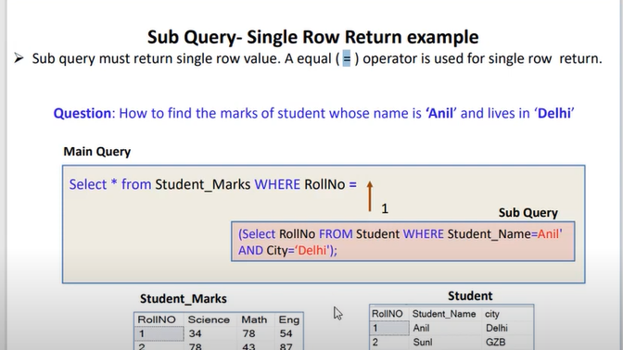

Slide 8
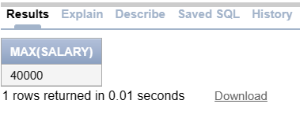
Write a SQL query to display maximum salary. Select Max(Salary) from Employee;

Slide 9
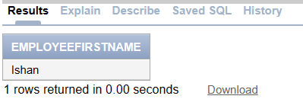
Write a SQL query to display employee name who is taking maximum salary.(Subquery) Select employeefirstname from Employee where Salary=(Select Max(Salary) from Employee);

Slide 10

Write SQL query to display second highest salary from Employee table Select Max(Salary) from Employee where Salary=(Select Max(Salary) from Employee where Salary<>(Select Max(Salary) from Employee));

